Slide 1
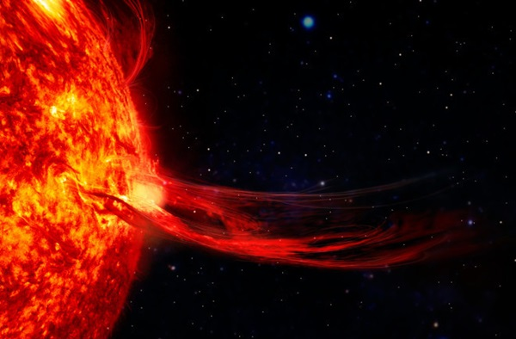
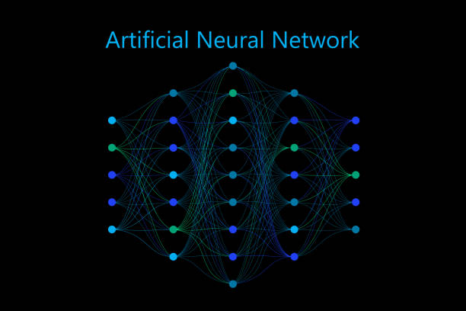

Transformer-based Atmospheric Density Forecasting
Julia Briden, Peng Mun Siew, Nicolette Clark,
Victor Rodriguez-Fernandez, and Richard Linares
Atmospherics / Space Weather
AMOS Conference
September 20, 2023
Research was sponsored by the United States Air Force Research Laboratory and the Department of the Air Force Artificial Intelligence Accelerator and was accomplished under Cooperative Agreement Number FA8750-19-2-1000. The views and conclusions contained in this document are those of the authors and should not be interpreted as representing the official policies, either expressed or implied, of the Department of the Air Force or the U.S. Government. The U.S. Government is authorized to reproduce and distribute reprints for Government purposes notwithstanding any copyright notation herein. This work was supported by a NASA Space Technology Graduate Research Opportunity and the National Science Foundation under award NSF-PHY-2028125.

Slide 2
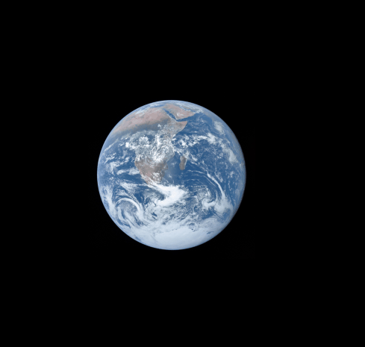
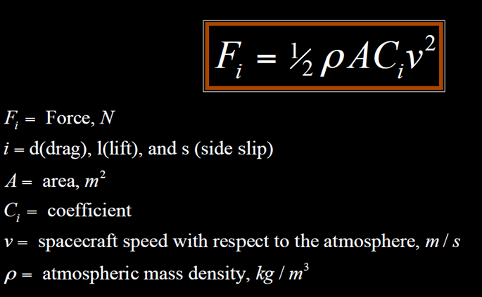
Atmospheric drag
Orbit without drag
Orbit with drag
The primary forces acting on a space object in LEO are atmospheric drag and gravitational attraction of the Earth
The largest error is generally due to inaccurate estimates of the thermospheric density 𝝆
Notes:
7,500 satellites in LEO
maneuvering every 2-3 weeks due to Orbital decay
Increases chances of collisions, increasing amount of debris
Accurate density nowcasts and forecasts
Improved orbit determination and prediction
Source: https://www.livescience.com/how-many-satellites-orbit-earth#:~:text=In%20total%2C%20there%20were%20around,Related%3A%20Does%20the%20moon%20rotate%3F
https://www.swpc.noaa.gov/impacts/satellite-drag#:~:text=When%20solar%20activity%20is%20at,maintain%20their%20orbit%20%5B1%5D.

Slide 3
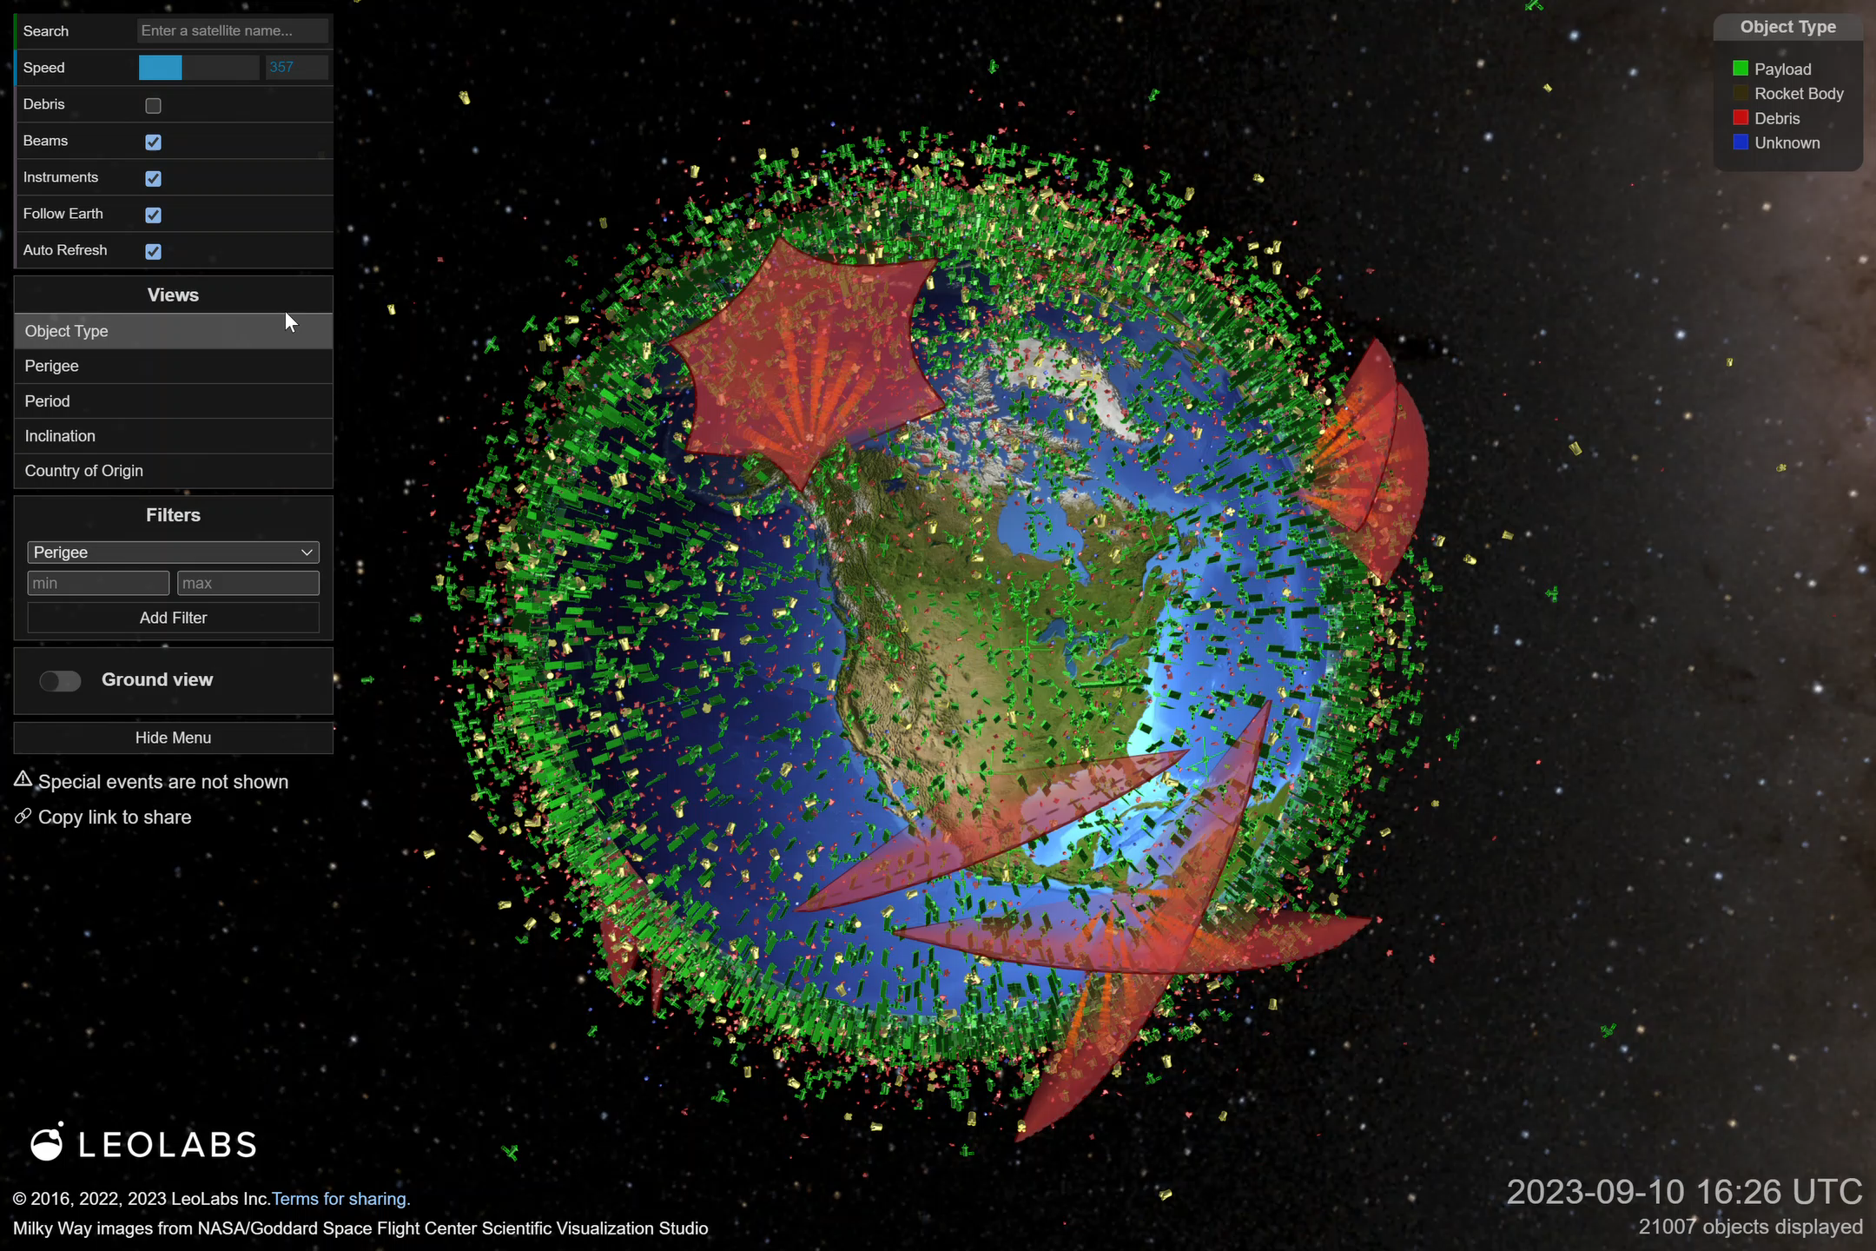
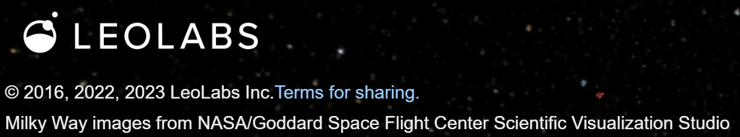
Atmospheric drag
Space debris
At the height of solar activity, over 7,500 LEO satellites must be maneuvered every 2-3 weeks
Over 500,000 1 – 10 cm space debris would cause catastrophic damage when colliding with a satellite
Notes:
7,500 satellites in LEO
maneuvering every 2-3 weeks due to Orbital decay
Increases chances of collisions, increasing amount of debris
Accurate density nowcasts and forecasts
Improved orbit determination and prediction
Source: https://www.livescience.com/how-many-satellites-orbit-earth#:~:text=In%20total%2C%20there%20were%20around,Related%3A%20Does%20the%20moon%20rotate%3F
https://www.swpc.noaa.gov/impacts/satellite-drag#:~:text=When%20solar%20activity%20is%20at,maintain%20their%20orbit%20%5B1%5D.

Slide 4
Atmospheric Density Modeling
Fidelity
Computational Efficiency

Slide 5
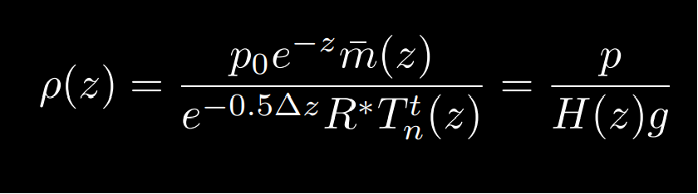
Atmospheric Density Modeling
Fidelity
Physics-based Models
- Require parallel resources for real-time evaluation
TIEGCM
High Altitude Observatory 2018: TIEGCM V1.94 Model Description.
Computational Efficiency

Slide 6
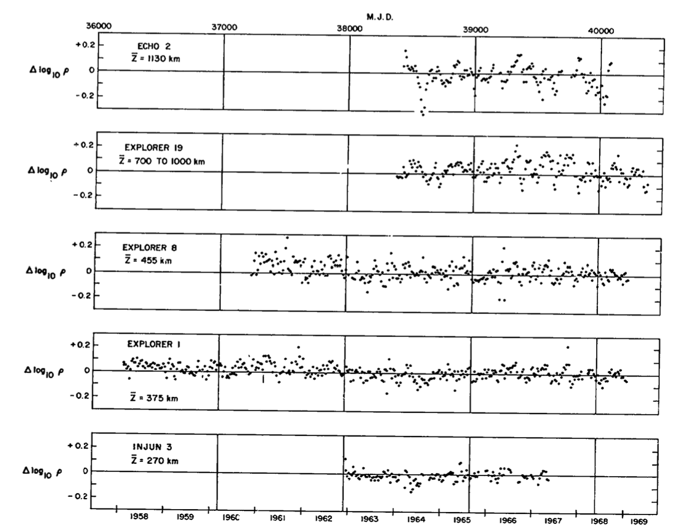
Atmospheric Density Modeling
Fidelity
Physics-based Models
TIEGCM
Empirical Models
- Limited forecasting ability
NRLMSISE-00
JB2008
Jacchia 1970: New static models of the thermosphere and exosphere with empirical temperature profiles.
Computational Efficiency

Slide 7
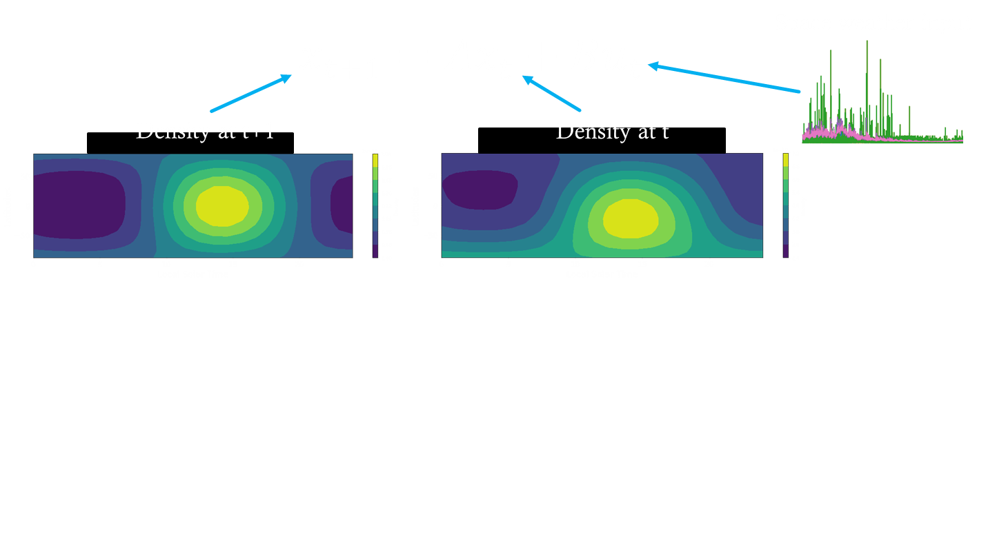
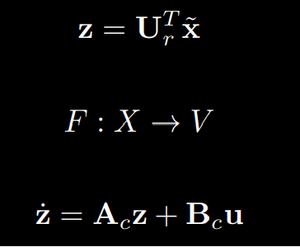
Atmospheric Density Modeling
Fidelity
Physics-based Models
TIEGCM
Empirical Models
Reduced-Order Models
TIEGCM ROM
NRLMSISE-00
JB2008
NRLMSISE-00 ROM
JB2008 ROM
+ Enables forecasting
+ Computationally fast
Briden 2022: Impact of Space Weather on Space Assets and Satellite Launches.
Computational Efficiency

Slide 8
Atmospheric Density Modeling
Fidelity
Physics-based Models
TIEGCM
Empirical Models
Reduced-Order Models
TIEGCM ROM
NRLMSISE-00
JB2008
NRLMSISE-00 ROM
JB2008 ROM
Computational Efficiency

Slide 9
Reduced-Order Modeling
1
Atmospheric Density Snapshot: Spatial Decomposition
2
Forecasting: Propagation in Time

Slide 10
Reduced-Order Modeling
1
Atmospheric Density Snapshot: Spatial Decomposition
2
Forecasting: Propagation in Time
Nonlinear
Linear

Slide 11
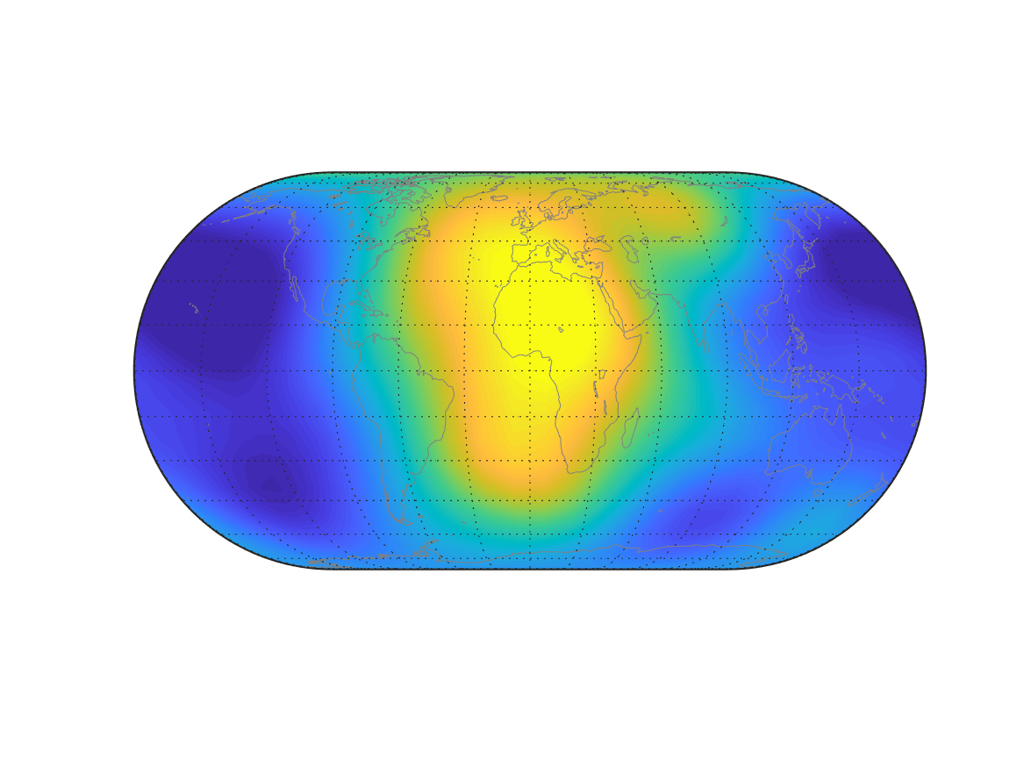
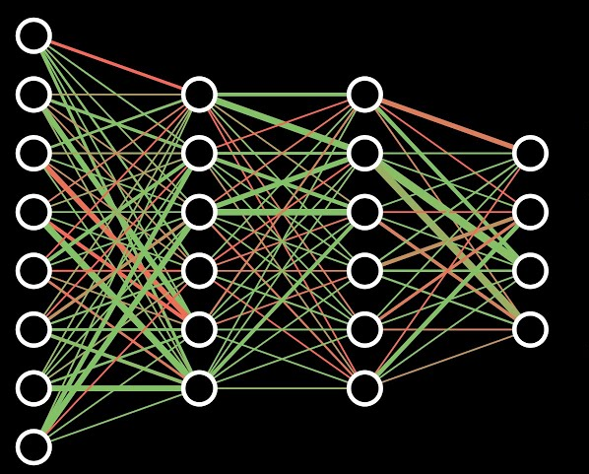
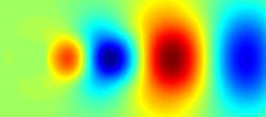
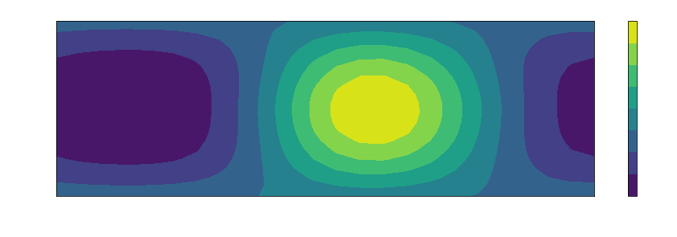
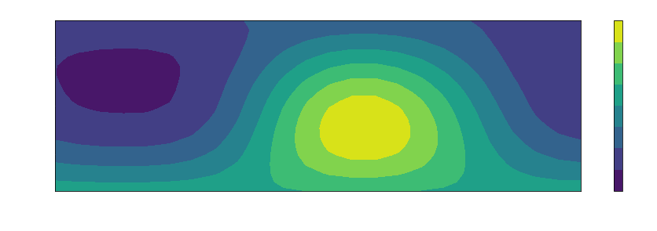
Reduced-Order Modeling
1
Atmospheric Density Snapshot: Spatial Decomposition
Proper Orthogonal Decomposition (POD)
Convolutional Autoencoder (ML)
2
Forecasting: Propagation in Time
Nonlinear
Dynamic Mode Decomposition with control (DMDc)
Linear

Slide 12
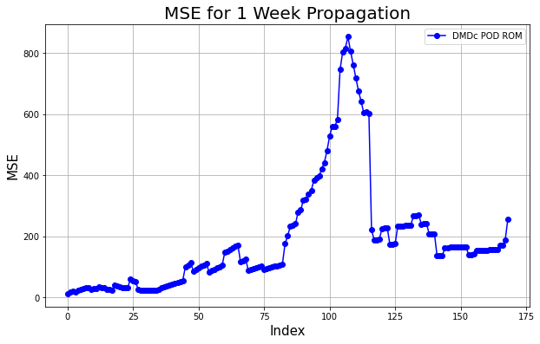
Reduced-Order Modeling
DMDc does not capture nonlinearities in the atmospheric density dynamics
DMDc is susceptible to noise sensitivity
2
Forecasting: Propagation in Time
Dynamic Mode Decomposition with control (DMDc)
Linear

Slide 13
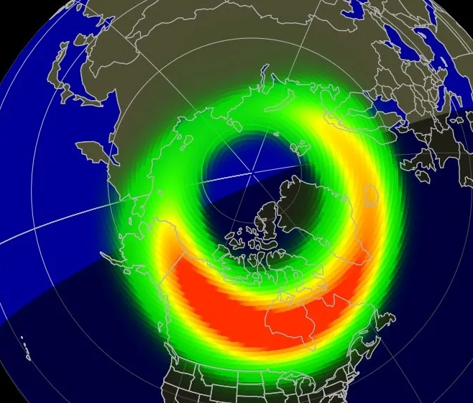
Reduced-Order Modeling
DMDc does not capture nonlinearities in the atmospheric density dynamics
DMDc is susceptible to noise sensitivity
Density due to fluctuations in geomagnetic and solar activity are inherently nonlinear
NOAA 2023: Aurora forecast.
2
Forecasting: Propagation in Time
Dynamic Mode Decomposition with control (DMDc)
Linear

Slide 14
Transformer-based Atmospheric Density Forecasting
+ Efficient nonlinear mapping of atmospheric density dynamics
2
Forecasting: Propagation in Time
Dynamic Mode Decomposition with control (DMDc)
Transformer-based Atmospheric Density Forecasting
Linear
Nonlinear

Slide 15
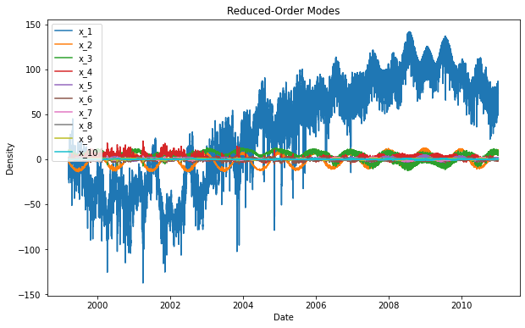
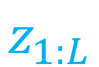

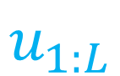
Transformer-based Atmospheric Density Forecasting
Reduced-order density state
$$z_{1:L}$$
For lookback window, L
Space weather indices
$$u_{1:L}$$
$$L$$

Slide 16
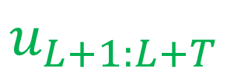
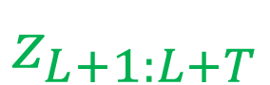

Transformer-based Atmospheric Density Forecasting
Reduced-order density state
$$z_{1:L}$$
Forecast for T timesteps
$$z_{L+1:L+T}$$
Space weather indices
$$u_{1:L}$$
$$u_{L+1:L+T}$$
$$L$$
$$T$$

Slide 17
Transformer-based Atmospheric Density Forecasting
PatchTST Architecture
$$z_{1:L}$$
Instance Norm + Patching
Transformer Encoder
Flatten + Linear head
$$z_{L+1:L+T}$$
Projection + Position Embedding
$$u_{1:L}$$
$$u_{L+1:L+T}$$
$$L$$
$$T$$

Slide 18
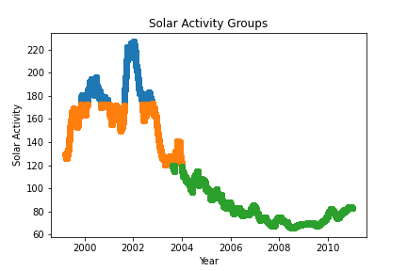
Transformer-based Propagator Training
F10B
High Solar Activity
Medium Solar Activity
Low Solar Activity
The F10B solar index’s range is divided into thirds using Pandas DataFrame operations

Slide 19
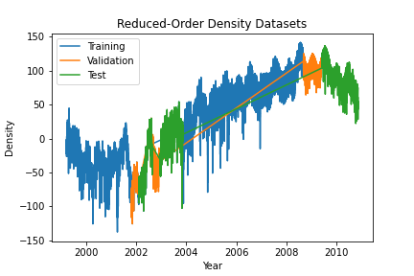
Transformer-based Propagator Training
F10B
Atmospheric Density
6-week lookback window, L, and 1-week forecast window, T
Training, validation, and test datasets include data from low, medium, and high solar activity time periods
20% test data, 10% validation data split
3,366,724 parameters
Loss converges in about 12 minutes using 2 GPUs

Slide 20
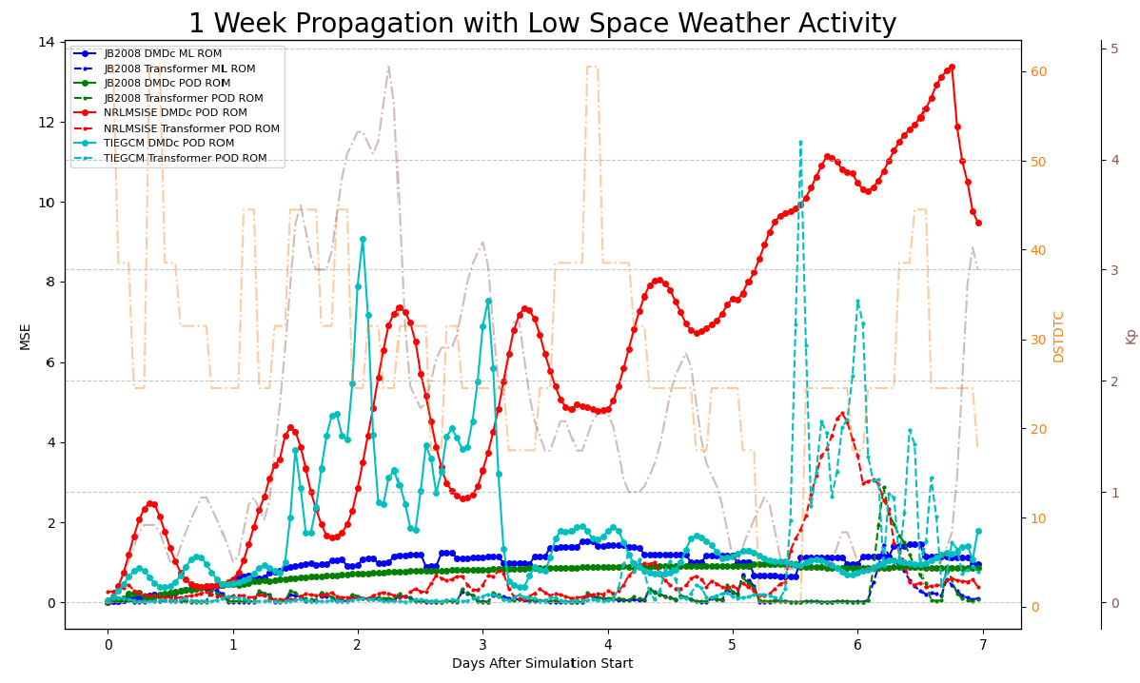
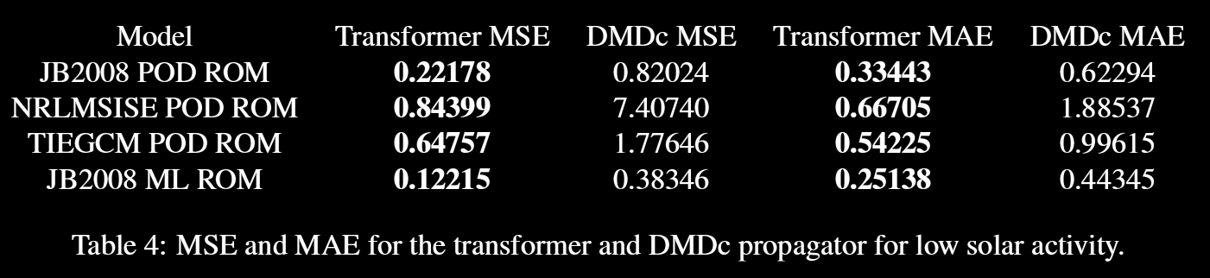
Results

Slide 21
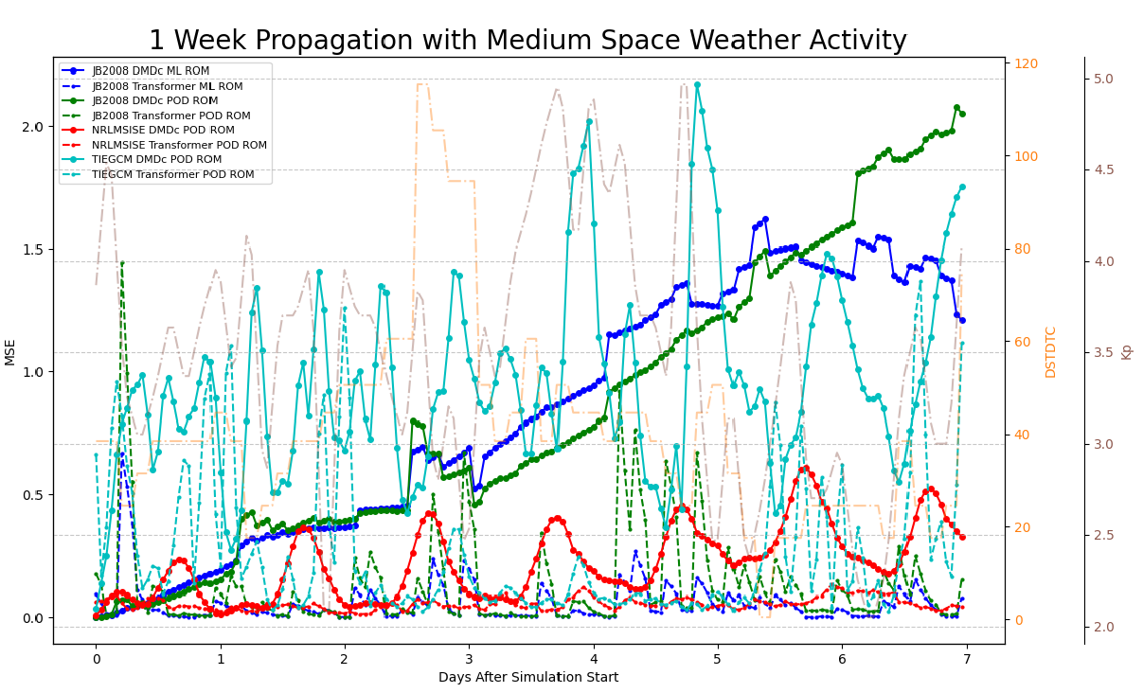
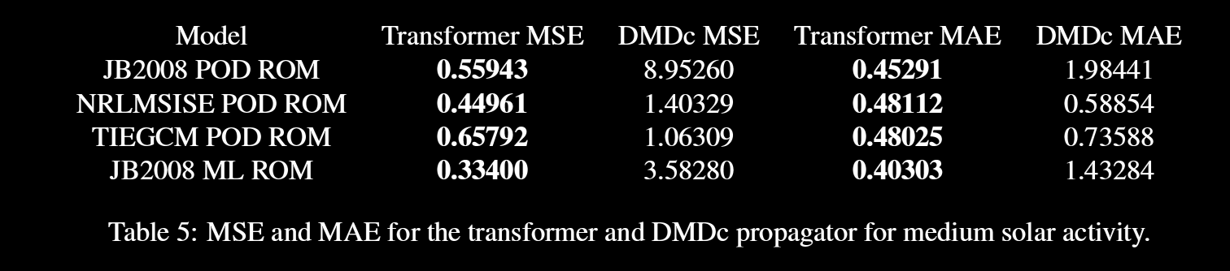
Results

Slide 22
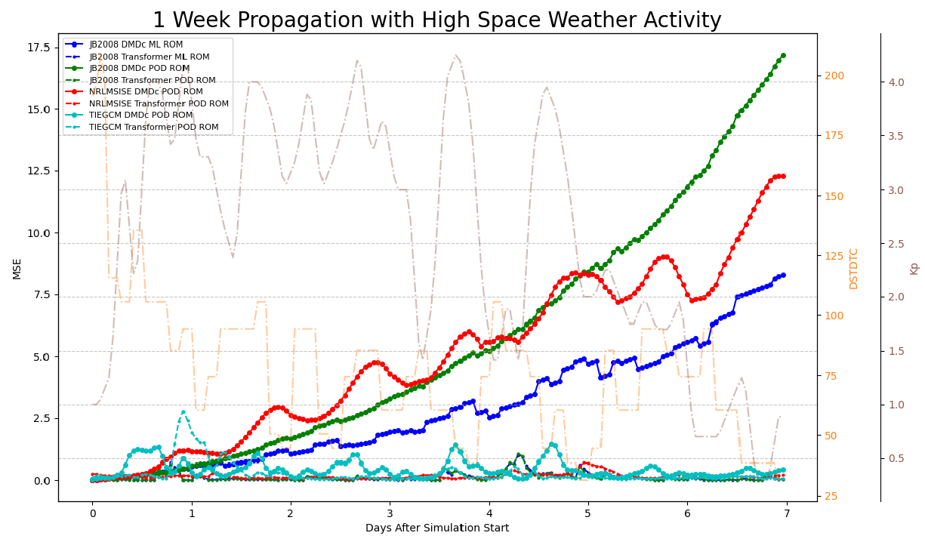
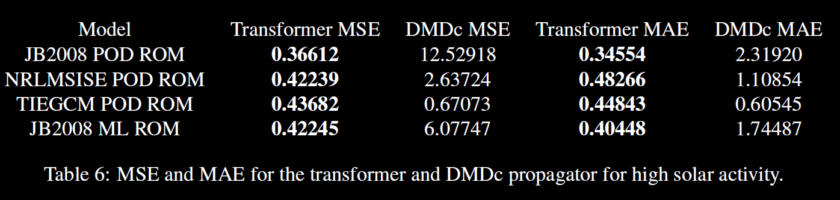
Results
Notes:
Overall, transformer forecasters are more robust to input data and provide lower errors across models
DMDc was found to be sensitive to out-of-distribution test data, quickly diverging during propagation
The Transformer architecture proved to be more computationally efficient than DMDc, forecasting 1-week time periods in only 1 step.

Slide 23
Conclusions and Future Work
Developed a nonlinear, Transformer-based, forecasting model for reduced-order atmospheric density
Transformer-based forecasting has been shown to be both accurate and robust when handling long-term dependencies in atmospheric density data, when compared to the linear DMDc forecaster
Future Work:
Implement a graph neural network to learn the cross-channel relationships between space weather indices and atmospheric density
Encode physics-based information in the Transformer’s loss function during training
Train new spatial reduced-order models that include the same training, validation, and test splits as the Transformer forecaster
Notes:
Models seem to be practically agreeing

Slide 24
Questions?
Contact: jbriden@mit.edu
References
[1] Ziyou Wu, Steven L. Brunton, and Shai Revzen. Challenges in dynamic mode decomposition. Journal of The Royal Society Interface, 2021.
[2] Turner H., Zhang M., D. Gondelach, , and R. Linares. Machine Learning Algorithms for Improved Thermospheric Density Modeling, volume 12312. Springer, Cham, 2020.
[3] Qingsong Wen, Tian Zhou, Chaoli Zhang, Weiqi Chen, Ziqing Ma, Junchi Yan, and Liang Sun. Transformers in time series: A survey. arXiv preprint arXiv:2202.07125, 2023. Accepted by 32nd International Joint Conference on Artificial Intelligence (IJCAI 2023).
[4] Julia Briden, Nicolette Clark, Peng Mun Siew, Richard Linares, and Tzu-Wei Fang. Impact of space weather on space assets and satellite launches. In 23rd Advanced Maui Optical and Space Surveillance Technologies. Advanced Maui Optical and Space Surveillance Technologies, 2022.
[5] Piyush M. Mehta and Richard Linares. A methodology for reduced order modeling and calibration of the upper atmosphere. Space Weather, 15(10):1270–1287, 2017.
[6] Sergey Ioffe and Christian Szegedy. Batch normalization: Accelerating deep network training by reducing internal covariate shift. Proceedings of the 32nd International Conference on Machine Learning, PMLR 37:448-456, 2015.
[7] R. A. DeCarlo. Linear systems: A state variable approach with numerical implementation. Upper Saddle River, NJ, USA: Prentice-Hall, Inc, 1989.
[8] Ian Goodfellow, Yoshua Bengio, and Aaron Courville. Deep Learning. MIT Press, 2016. http://www.deeplearningbook.org.
[9] Yuqi Nie, Nam H. Nguyen, Phanwadee Sinthong, and Jayant Kalagnanam. A time series is worth 64 words: Long-term forecasting with transformers. In International Conference on Learning Representations (ICLR), 2023.
[10] Ignacio Oguiza. tsai - a state-of-the-art deep learning library for time series and sequential data. Github, 2022.
[11] David J. Gondelach and Richard Linares. Real-Time Thermospheric Density Estimation via Two-Line Element Data Assimilation. Space Weather, 18(2):e2019SW002356, 2020

Slide 25
Backups

Slide 26
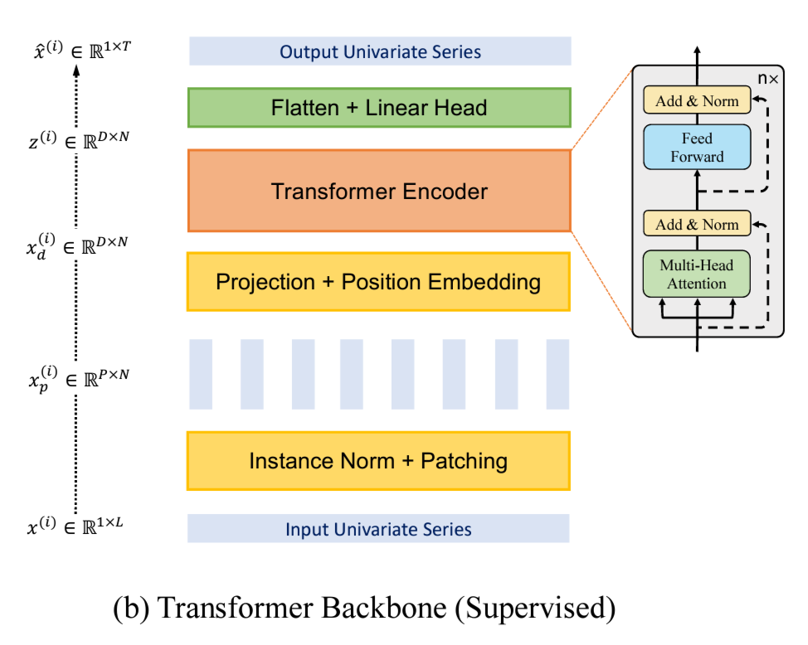
Transformer Propagator Architecture

Slide 27
Transformer-based Atmospheric Density Forecasting
arch_config = dict(
n_layers=1, # number of encoder layers
n_heads=2, # number of heads
d_model=20, # dimension of model
d_ff=28, # dimension of fully connected network
attn_dropout=0.0, # dropout applied to the attention weights
dropout=0.2, # dropout applied to all linear layers in the encoder except q,k&v projections
patch_len=9, # length of the patch applied to the time series to create patches
stride=1, # stride used when creating patches
padding_patch=True, # padding_patch
)
# TST
learn = TSForecaster(X, y, splits=combined_splits, batch_size=1, path="models", pipelines=[exp_pipe],
arch="PatchTST", arch_config=arch_config, metrics=[mse, mae], cbs=ShowGraph(), init=True)

Slide 28
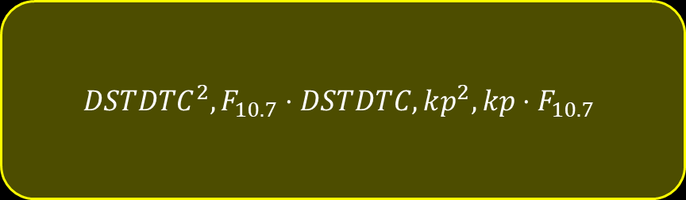

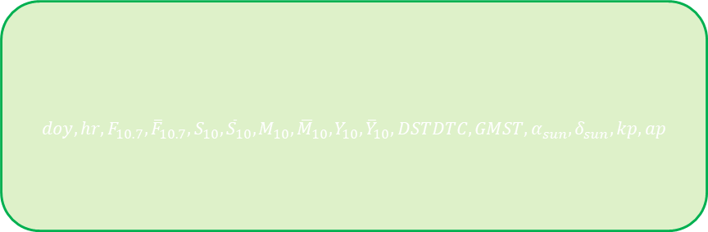

Prediction: Space Weather Input
$$x_{t+1}=Ax_{t}+Bu_{t}$$
Space weather input
Standard Input
$$doy, hr,F_{10.7},{\overline{F}}_{10.7},S_{10}, {\overline{S}}_{10},M_{10},{\overline{M}}_{10},Y_{10},{\overline{Y}}_{10}, DSTDTC, GMST, α_{sun},δ_{sun},kp,ap$$
Future Input
$$F_{10.7},S_{10},M_{10},Y_{10},DSTDTC,kp$$
Nonlinear Input
$$DSTDTC^{2},F_{10.7}⋅DSTDTC, kp^{2},kp⋅F_{10.7}$$
Notes:
F10.7 Solar radio noise flux at a wavelength of 10.7 cm, JB2008, POD TIE-GCM ROM, NRLMSISE-00
S10 Activity indicator of the integrated 26-34 nm solar irradiance, JB2008
M10 Modified daily Mg II core-to-wing ratio, JB2008
DSTDTC Temperature change calculated from the Disturbance Storm Time (DST) Index, JB2008
kp 3-hour-range standardized quasi-logarithmic magnetic activity, POD TIE-GCM ROM
ap 3-hourly magnetic activity index derived from kp, NRLMSISE-00 (3) (PDF) Impact of Space Weather on Space Assets and Satellite Launches. Available from: https://www.researchgate.net/publication/364154160_Impact_of_Space_Weather_on_Space_Assets_and_Satellite_Launches [accessed Feb 03 2023].

Slide 29
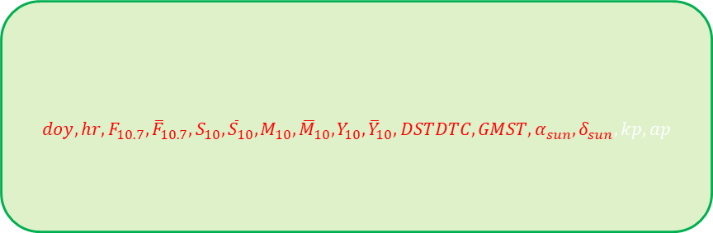
Prediction: Space Weather Input
$$x_{t+1}=Ax_{t}+Bu_{t}$$
Space weather input
Standard Input
$$doy, hr,F_{10.7},{\overline{F}}_{10.7},S_{10}, {\overline{S}}_{10},M_{10},{\overline{M}}_{10},Y_{10},{\overline{Y}}_{10}, DSTDTC, GMST, α_{sun},δ_{sun},kp,ap$$
JB2008
Future Input
$$F_{10.7},S_{10},M_{10},Y_{10},DSTDTC,kp$$
Nonlinear Input
$$DSTDTC^{2},F_{10.7}⋅DSTDTC, kp^{2},kp⋅F_{10.7}$$
Notes:
F10.7 Solar radio noise flux at a wavelength of 10.7 cm, JB2008, POD TIE-GCM ROM, NRLMSISE-00
S10 Activity indicator of the integrated 26-34 nm solar irradiance, JB2008
M10 Modified daily Mg II core-to-wing ratio, JB2008
DSTDTC Temperature change calculated from the Disturbance Storm Time (DST) Index, JB2008
kp 3-hour-range standardized quasi-logarithmic magnetic activity, POD TIE-GCM ROM
ap 3-hourly magnetic activity index derived from kp, NRLMSISE-00 (3) (PDF) Impact of Space Weather on Space Assets and Satellite Launches. Available from: https://www.researchgate.net/publication/364154160_Impact_of_Space_Weather_on_Space_Assets_and_Satellite_Launches [accessed Feb 03 2023].

Slide 30
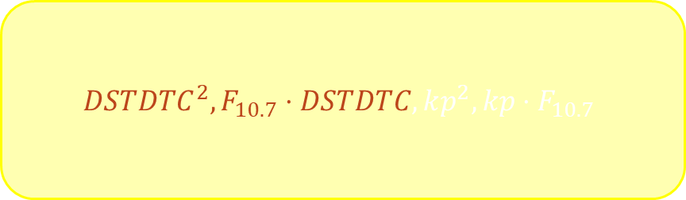

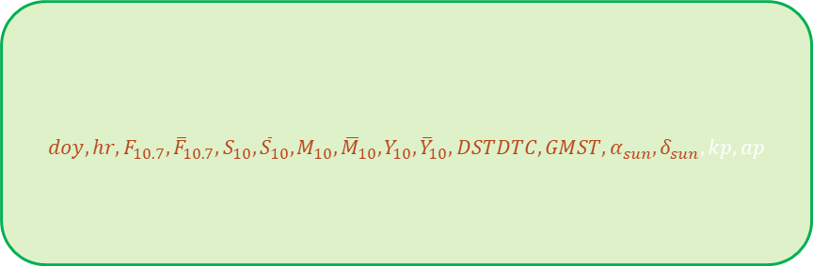
Prediction: Space Weather Input
$$x_{t+1}=Ax_{t}+Bu_{t}$$
Space weather input
Standard Input
$$doy, hr,F_{10.7},{\overline{F}}_{10.7},S_{10}, {\overline{S}}_{10},M_{10},{\overline{M}}_{10},Y_{10},{\overline{Y}}_{10}, DSTDTC, GMST, α_{sun},δ_{sun},kp,ap$$
JB2008 ROM
Future Input
$$F_{10.7},S_{10},M_{10},Y_{10},DSTDTC,kp$$
Nonlinear Input
$$DSTDTC^{2},F_{10.7}⋅DSTDTC, kp^{2},kp⋅F_{10.7}$$
Notes:
F10.7 Solar radio noise flux at a wavelength of 10.7 cm, JB2008, POD TIE-GCM ROM, NRLMSISE-00
S10 Activity indicator of the integrated 26-34 nm solar irradiance, JB2008
M10 Modified daily Mg II core-to-wing ratio, JB2008
DSTDTC Temperature change calculated from the Disturbance Storm Time (DST) Index, JB2008
kp 3-hour-range standardized quasi-logarithmic magnetic activity, POD TIE-GCM ROM
ap 3-hourly magnetic activity index derived from kp, NRLMSISE-00 (3) (PDF) Impact of Space Weather on Space Assets and Satellite Launches. Available from: https://www.researchgate.net/publication/364154160_Impact_of_Space_Weather_on_Space_Assets_and_Satellite_Launches [accessed Feb 03 2023].

Slide 31
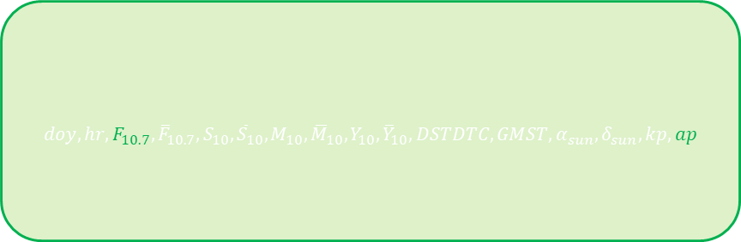
Prediction: Space Weather Input
$$x_{t+1}=Ax_{t}+Bu_{t}$$
Space weather input
Standard Input
$$doy, hr,F_{10.7},{\overline{F}}_{10.7},S_{10}, {\overline{S}}_{10},M_{10},{\overline{M}}_{10},Y_{10},{\overline{Y}}_{10}, DSTDTC, GMST, α_{sun},δ_{sun},kp,ap$$
Future Input
$$F_{10.7},S_{10},M_{10},Y_{10},DSTDTC,kp$$
NRLMSISE-00
Nonlinear Input
$$DSTDTC^{2},F_{10.7}⋅DSTDTC, kp^{2},kp⋅F_{10.7}$$
Notes:
F10.7 Solar radio noise flux at a wavelength of 10.7 cm, JB2008, POD TIE-GCM ROM, NRLMSISE-00
S10 Activity indicator of the integrated 26-34 nm solar irradiance, JB2008
M10 Modified daily Mg II core-to-wing ratio, JB2008
DSTDTC Temperature change calculated from the Disturbance Storm Time (DST) Index, JB2008
kp 3-hour-range standardized quasi-logarithmic magnetic activity, POD TIE-GCM ROM
ap 3-hourly magnetic activity index derived from kp, NRLMSISE-00 (3) (PDF) Impact of Space Weather on Space Assets and Satellite Launches. Available from: https://www.researchgate.net/publication/364154160_Impact_of_Space_Weather_on_Space_Assets_and_Satellite_Launches [accessed Feb 03 2023].

Slide 32
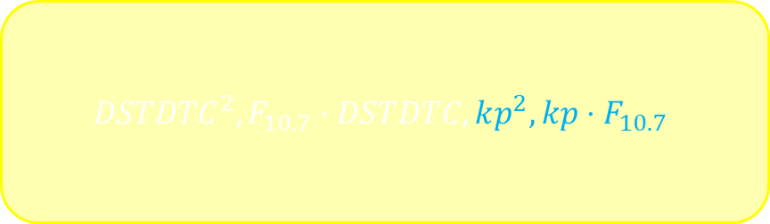

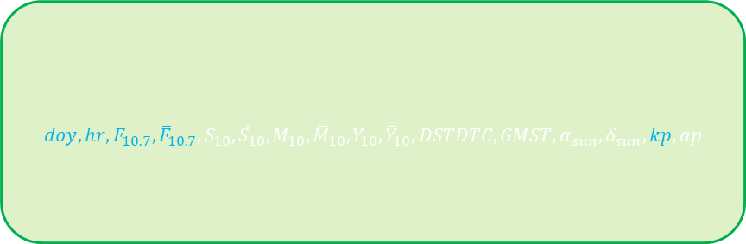
Prediction: Space Weather Input
$$x_{t+1}=Ax_{t}+Bu_{t}$$
Space weather input
Standard Input
$$doy, hr,F_{10.7},{\overline{F}}_{10.7},S_{10}, {\overline{S}}_{10},M_{10},{\overline{M}}_{10},Y_{10},{\overline{Y}}_{10}, DSTDTC, GMST, α_{sun},δ_{sun},kp,ap$$
Future Input
$$F_{10.7},S_{10},M_{10},Y_{10},DSTDTC,kp$$
Nonlinear Input
$$DSTDTC^{2},F_{10.7}⋅DSTDTC, kp^{2},kp⋅F_{10.7}$$
TIE-GCM ROM
Notes:
F10.7 Solar radio noise flux at a wavelength of 10.7 cm, JB2008, POD TIE-GCM ROM, NRLMSISE-00
S10 Activity indicator of the integrated 26-34 nm solar irradiance, JB2008
M10 Modified daily Mg II core-to-wing ratio, JB2008
DSTDTC Temperature change calculated from the Disturbance Storm Time (DST) Index, JB2008
kp 3-hour-range standardized quasi-logarithmic magnetic activity, POD TIE-GCM ROM
ap 3-hourly magnetic activity index derived from kp, NRLMSISE-00 (3) (PDF) Impact of Space Weather on Space Assets and Satellite Launches. Available from: https://www.researchgate.net/publication/364154160_Impact_of_Space_Weather_on_Space_Assets_and_Satellite_Launches [accessed Feb 03 2023].

Slide 33
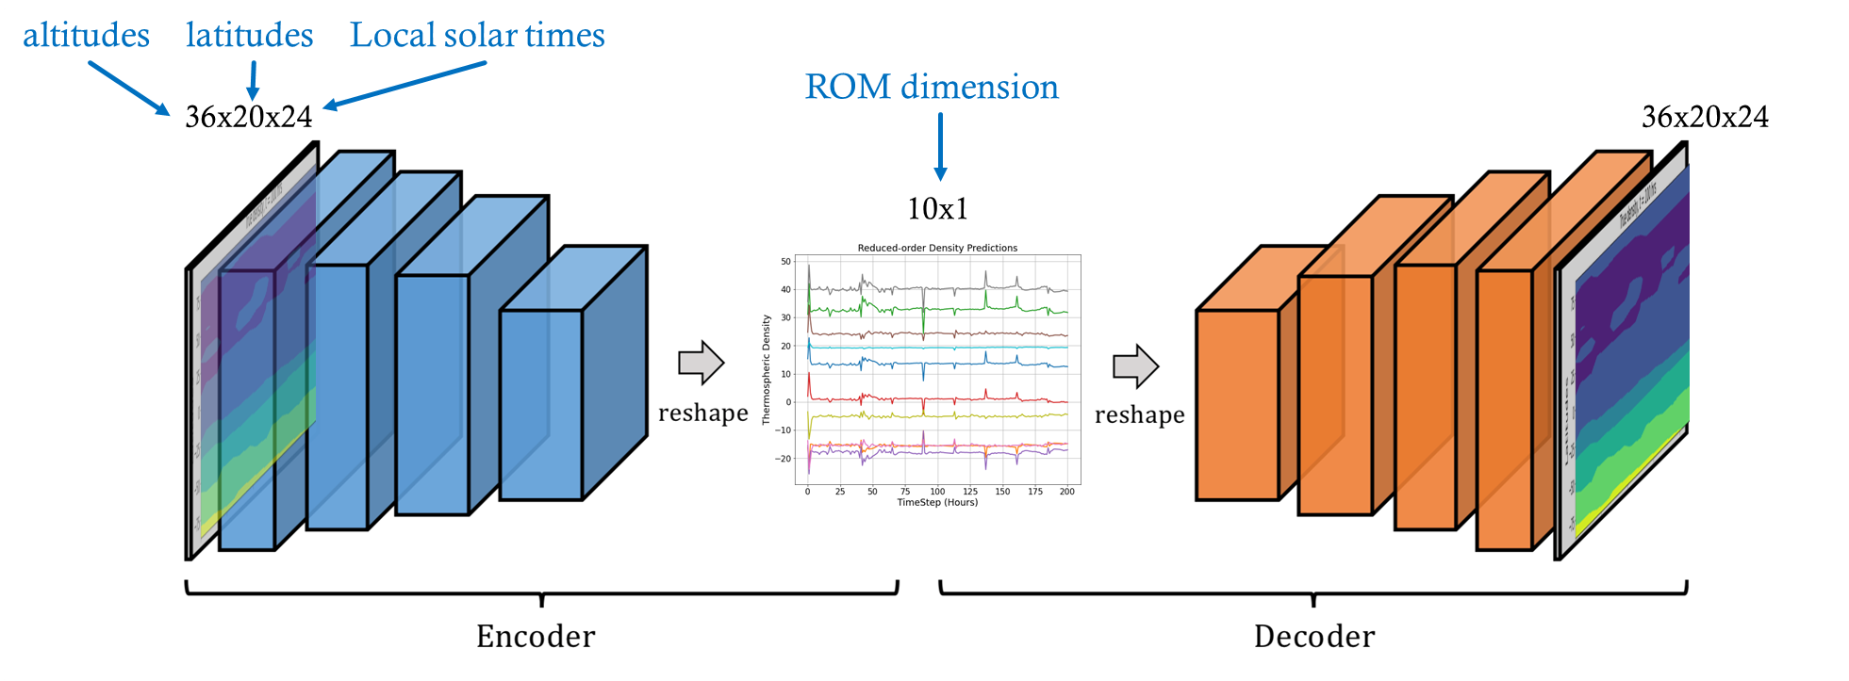
Reduced-order modeling
Machine Learning (ML) Convolutional Autoencoder model trained with density data from the JB-2008 model (empirical)
Proper Orthogonal Decomposition (POD) model trained with density data from the JB-2008 model (empirical) and TIE-GCM model (physics-based)
Notes:
Computationally fast
Low-dimensional ⇨ low number of variables to be estimated
Most energetic modes ⇨ ‘optimal’ low-order representation
Orthogonal modes ⇨ good observability
Dynamic:
Forecasting ability
Real-time
Kalman filtering
Enables orbit data as point-measurements (using Kalman filter)
Autoencoder:
Learn to reconstruct data (Unsupervised learning)
Encode data to low-dimensional representation
Decode to reconstruct original data
Optimize NN architecture:
Convolutional layers: # of layers, # of filters, size, etc.
Autoencoder architecture is a general image. Different architecture for JB2008 and TIEGCM

Slide 34
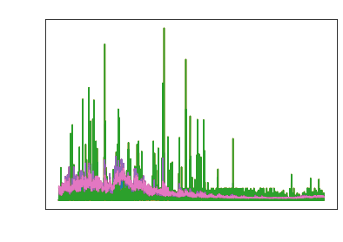
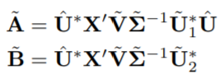
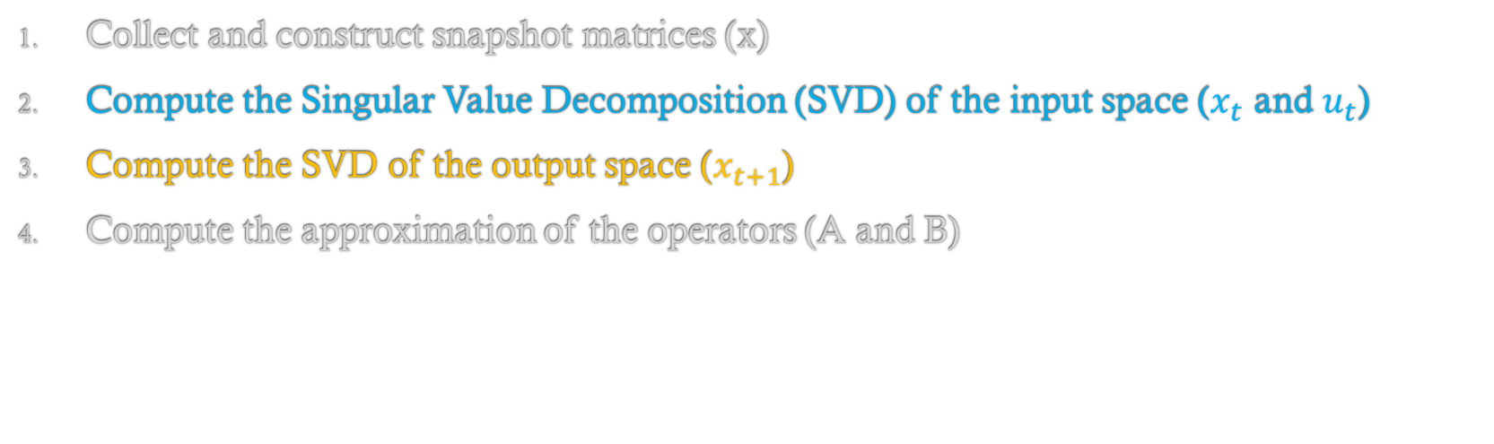
Prediction: Dynamic mode decomposition with control
Space weather input
$$x_{t+1}=Ax_{t}+Bu_{t}$$
Density at t+1
Density at t
Collect and construct snapshot matrices (x)
Compute the Singular Value Decomposition (SVD) of the input space ($x_{t}$ and $u_{t}$)
Compute the SVD of the output space ($x_{t+1}$)
Compute the approximation of the operators (A and B)
Proctor 2014: Dynamic mode decomposition with control.
Notes:
Use reduced order form of DMDc

Slide 35
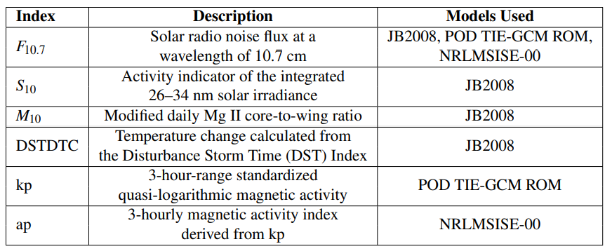
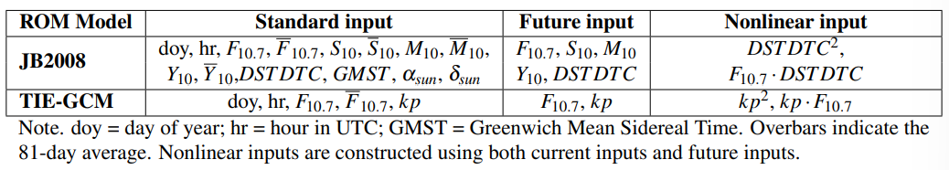
Space Weather Inputs

Slide 36
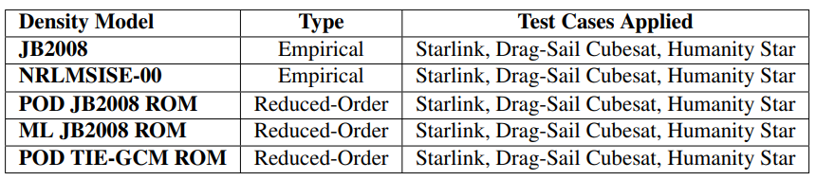
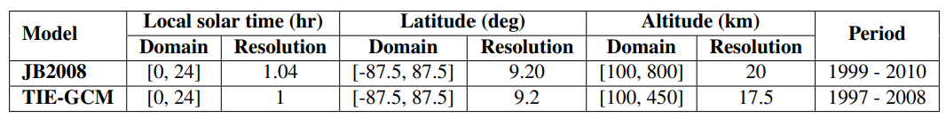
Atmospheric Density Models
Notes:
project the high-dimensional system and its solution ontoa set of low-dimensional basis functions or spatial modes, while capturing the dominant characteristics ofthe system

Slide 37
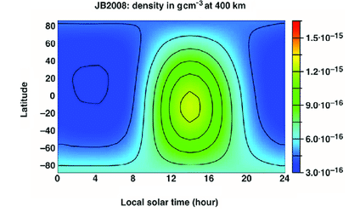
DESTO: Reduced-Order State Estimation
20 Space objects active for each deorbit case, at a range of altitudes, and with accurate available BC estimates
TLE data
SGP4/SDP4 simplified perturbation model
Orbital state vector
r
v
Bruinsma 2012: JB2008
Estimated state
x = [p₁,𝑓₁,g₁,h₁,k₁,L₁,BC₁, ... ,p_{n},𝑓_{n},g_{n},h_{n},k_{n},L_{n},BC_{n}, z^{T}]^{T}
Notes:
predict the effect of perturbations caused by the Earth’s shape, drag, radiation, and gravitation effects from other bodies such as the sun and moon.^{[1][2]} Simplified General Perturbations (SGP) models apply to near earth objects with an orbital period of less than 225 minutes. Simplified Deep Space Perturbations (SDP) models apply to objects with an orbital period greater than 225 minutes, which corresponds to an altitude of 5,877.5 km, assuming a circular orbit. TLEs have +/- 1-2 km errors

Slide 38
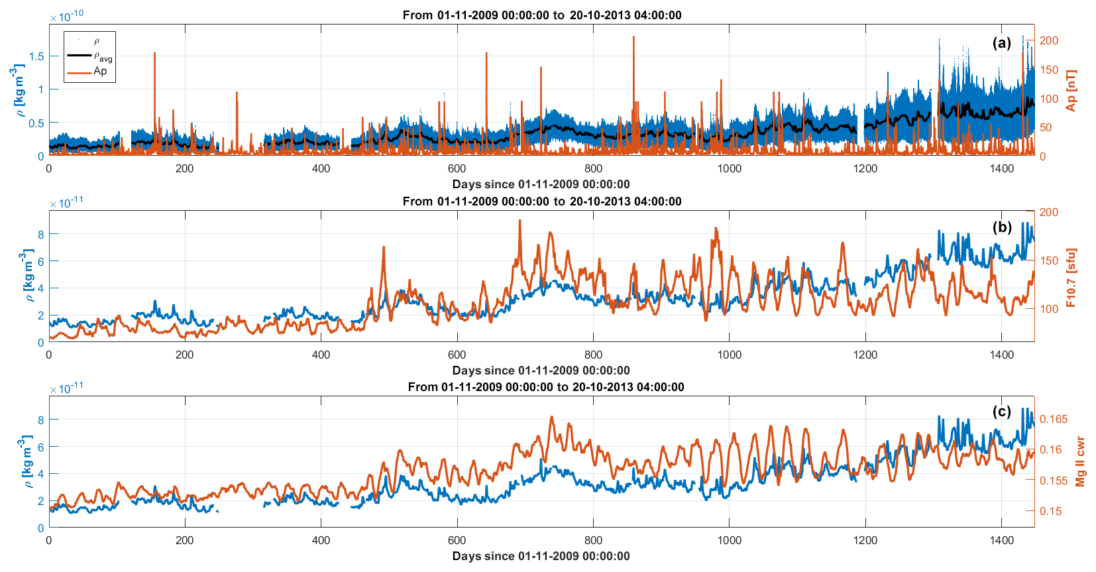
Thermospheric density
Function of solar activity
Bigazzi 2020 - Lower-thermosphere response to solar activity: an empirical-mode-decomposition analysis of GOCE 2009–2012 data

Slide 39
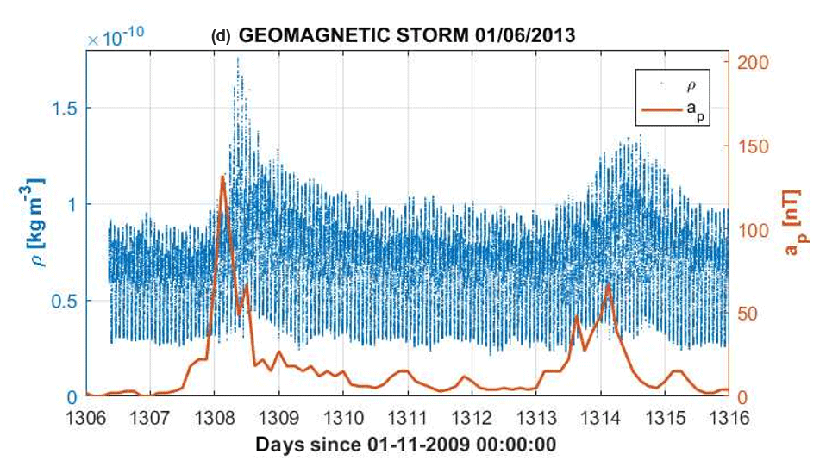
Thermospheric density
Function of geomagnetic activity
Bigazzi 2020 - Lower-thermosphere response to solar activity: an empirical-mode-decomposition analysis of GOCE 2009–2012 data

Slide 40


Density and Space weather data
Density snapshot data generated using:
TIE-GCM simulations
NRLMSISE-00 model
JB2008 model
Space weather data:
Time: day of year, hour
Solar activity: F10.7, S10, M10, Y10
Geomagnetic indices: ap, Kp, DSTDTC
Nonlinear: ap², ap･F10.7
Density data
Space weather inputs

Slide 41

Space weather activity
Solar coronal mass ejection
Solar wind magnetic fields
Earth’s magnetosphere
Sun
Earth
CMEs bringing solar wind particles and electric fields cause disturbances in Earth’s electric fields.
Joule heating from electric fields causes Earth’s atmospheric temperature and density to rise.
Solar active region
Solar energy particles
ESA 2003: Coronal mass ejection (CME) blast and subsequent impact at Earth.
Baker 2015: Resource Letter SW1: Space Weather.
Notes:
CMEs: Eruptions of plasma and magnetic field structures, known as coronal mass ejections (CMEs -> Earth’s atmospheric temperature rises due to Joule heating from electric fields in the ionosphere [33, 10]. The atmospheric heating from solar activity and the transient solar wind from Earth-directed CMEs determine the level of geomagnetic activity, sometimes resulting in geomagnetic storms

Slide 42

Space weather activity
Notes:
CMEs: Eruptions of plasma and magnetic field structures, known as coronal mass ejections (CMEs -> Earth’s atmospheric temperature rises due to Joule heating from electric fields in the ionosphere [33, 10]. The atmospheric heating from solar activity and the transient solar wind from Earth-directed CMEs determine the level of geomagnetic activity, sometimes resulting in geomagnetic storms

